Slide 1
Dianna Tran, Molly Ingram, Miguel Gómez, Pat Canning, Jeff Bloem and Chris Barrett ASTAR virtual workshop November 8, 2022
Ten stylized facts about how agri-food value chain employment and compensation changes with structural transformation
The findings and conclusions in this presentation are those of the authors and should not be construed to represent any official USDA or U.S. Government determination or policy. This research was funded in part through Cooperative Agreement number 58-4000-1-0080 between Cornell University and the Economic Research Service of the U.S. Department of Agriculture.

Slide 2
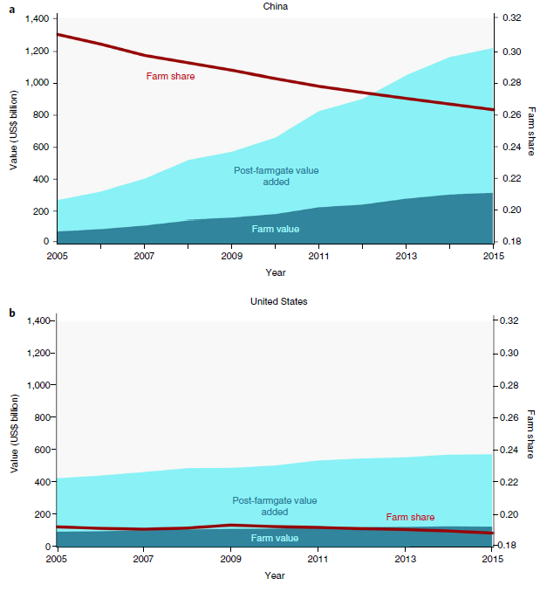
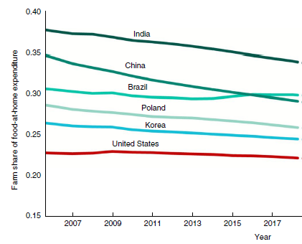
Motivation
Usual structural transformation narrative concerns the relative decline of (slow growing) agriculture.
But as incomes grow, consumers demand more convenience, quality, safety, variety, etc. and farm share of consumer food expenditures falls (Yi et al. Nature Food 2021; Barrett et al. J.Econ.Lit 2022)
Source: Yi et al. (Nature Food 2021)

Slide 3
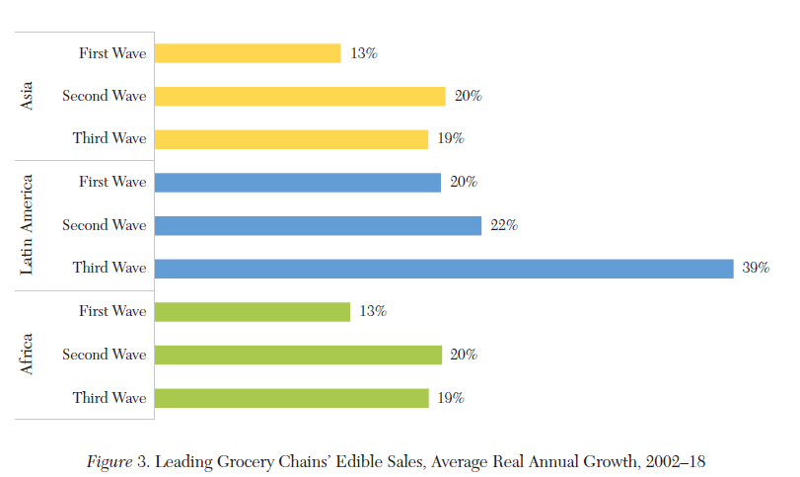
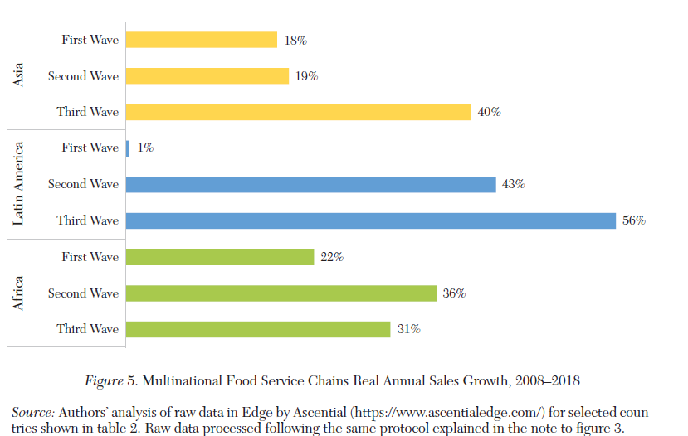
Motivation
The downstream shift in value addition towards consumer-facing AVC segments (retail and food service) is mirrored in firm growth rates.
LMIC grocery stores LMIC MNC food service
Source: Barrett et al. (J. Econ. Lit. 2022)

Slide 4
Motivation
Given downstream shift in value-addition, what happens to employment/compensation across AVC?
Build on Global Food Dollar method and Food Dollar’s factor and industry decomposition methods.
Use OECD national accounts and food expenditure data 2005-15 from high- and middle-income countries to decompose domestic food consumption value addition across five key AVC industries: 1) Primary production, 2) Processing, 3) Transportation and storage, 4) Wholesale and retail, 5) Food service.
Also generate labor share of total value addition.
N=61 for FAAFH, 37 for FTAH, 10 for FAH.

Slide 5
Motivation
Given downstream shift in value-addition, what happens to employment/compensation across AVC?
Build on Global Food Dollar method and Food Dollar’s factor and industry decomposition methods.
2) Add SITC-specific ILO labor data (15+ yo, primary F-T job):
Food at home (FAH): 4 countries - Chile, Colombia, Mexico, USA
Food and tobacco at home (FTAH): 5 countries - + Turkey
Food and accommodations away from home (FAAFH): 16 countries - + Brazil, Brunei, Cambodia, Costa Rica, India, Israel, Japan, Peru, Philippines, Thailand, Vietnam

Slide 6
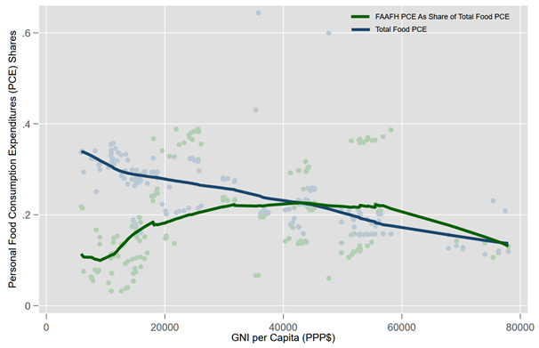
10 Stylized facts
1. Food share of consumer expenditures falls and shifts toward FAFH as incomes rise.

Slide 7
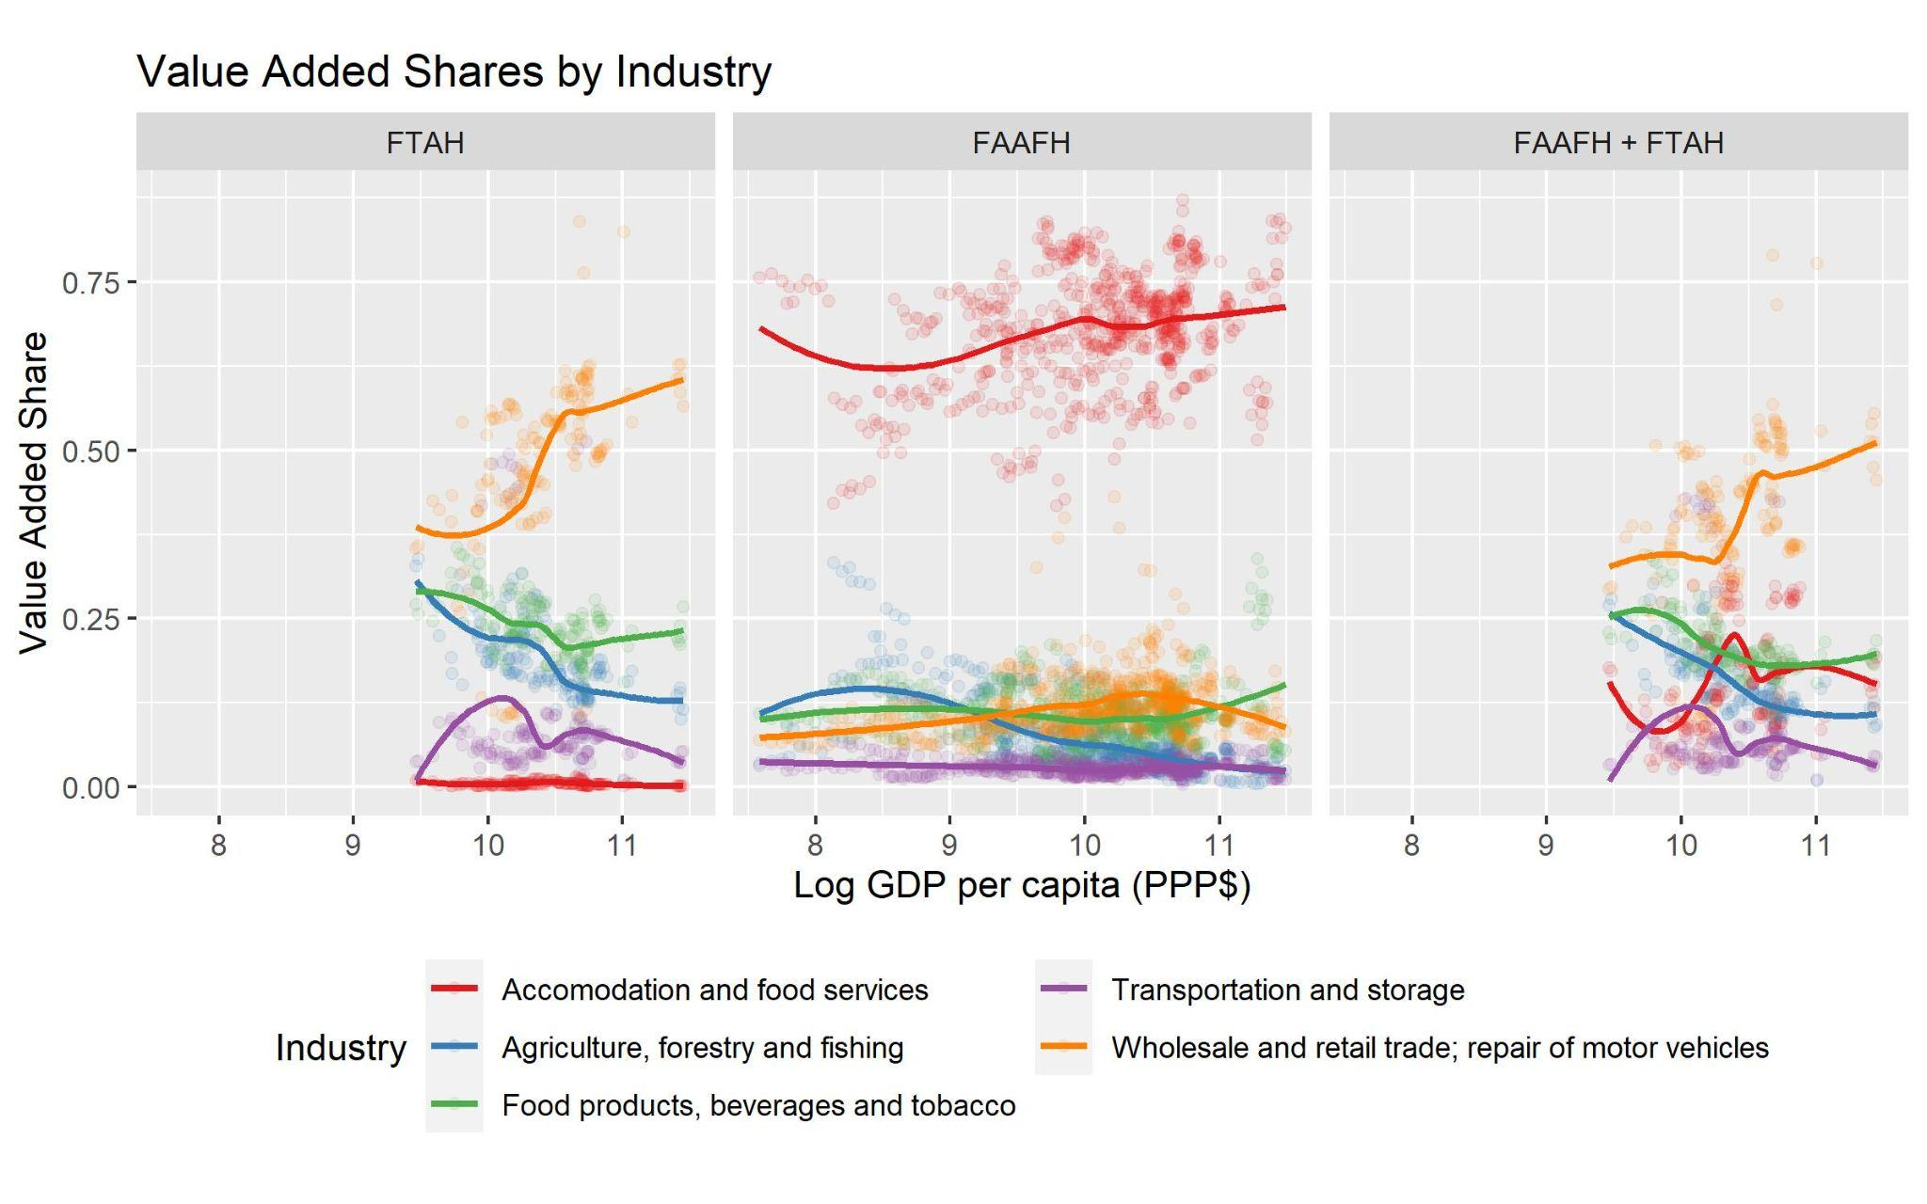
10 Stylized facts
2. Value addition patterns differ b/n FAH and FAAFH and exhibit different evolution w/income growth.
Note: LIC ~<7
LMIC [7,8.4]
UMIC [8.4,9.5]
HIC >9.5
Primary production (AFF) share falls steadily, as consumer-facing value addition (food service, retail/wholesale) rises most.

Slide 8
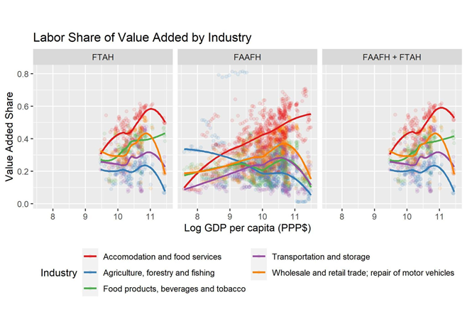
10 Stylized facts
3. Food service most labor intensive of AVC industries.
Once past LMIC stage, food service becomes most labor intensive AVC industry. So labor profile of AVC evolution influenced heavily by rise in FAFH.

Slide 9
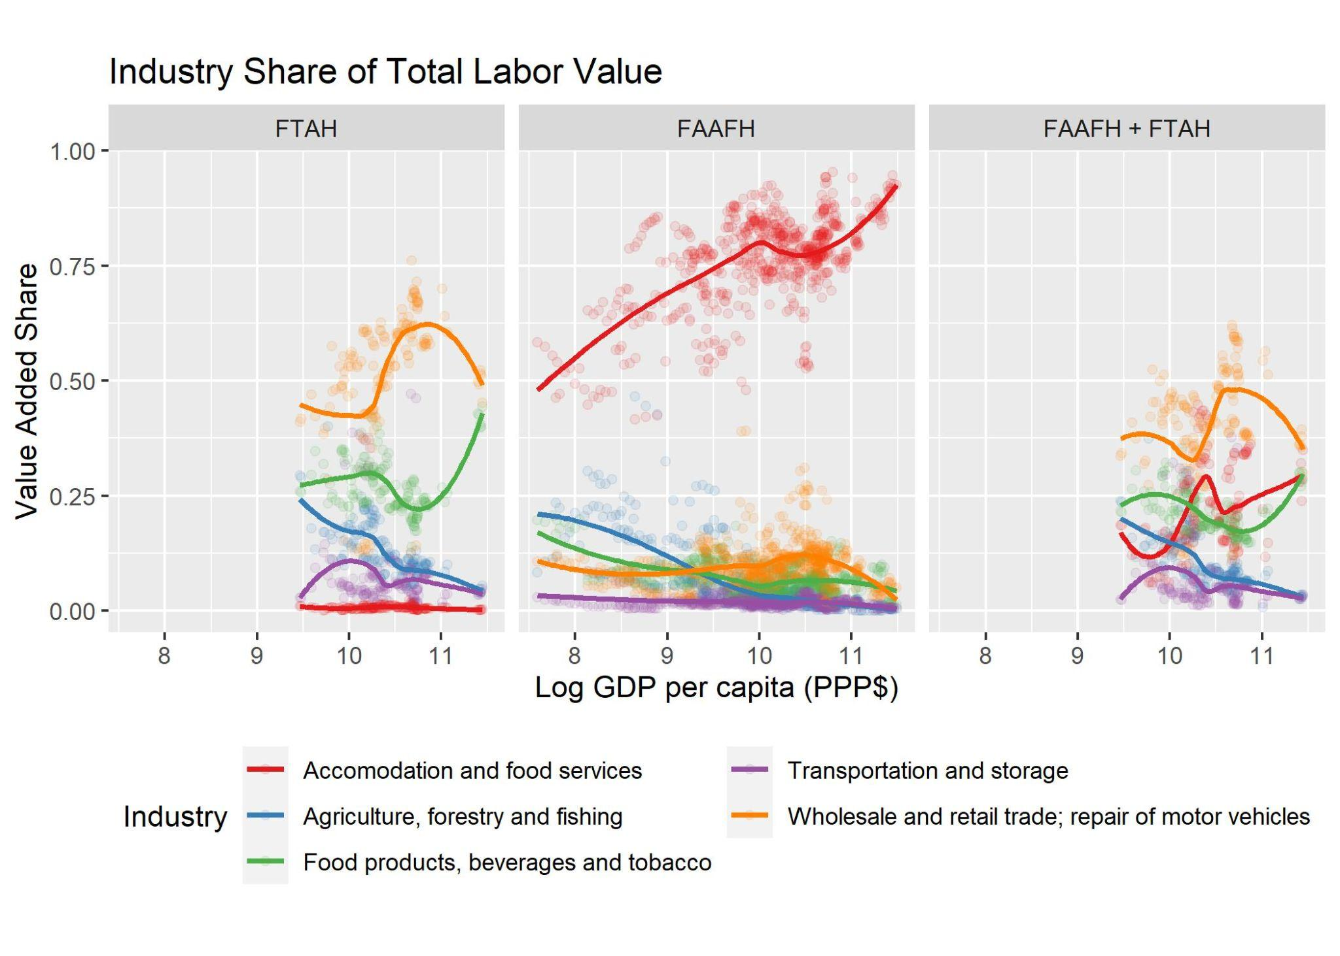
10 Stylized facts
4. Industry share of AVC labor value addition patterns differ b/n FAH and FAAFH and as incomes rise.
AFF labor share falls even faster than VA, as food service labor value addition rises fastest.

Slide 10
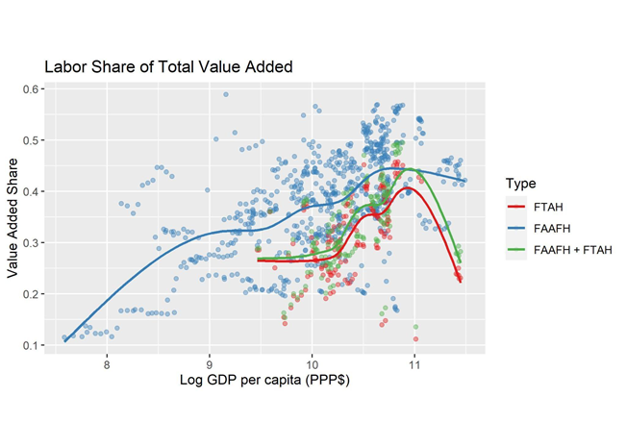
10 Stylized facts
5. Labor share of total AVC value addition rises over most of the income range.
Especially in FAFH, labor share of AVC VA increases steadily from LMIC to HIC.

Slide 11
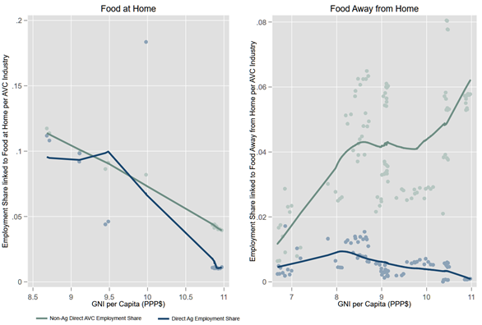
10 Stylized facts
6. While primary production employment generating FAH falls as % total jobs in economy, FAFH share rises.

Slide 12
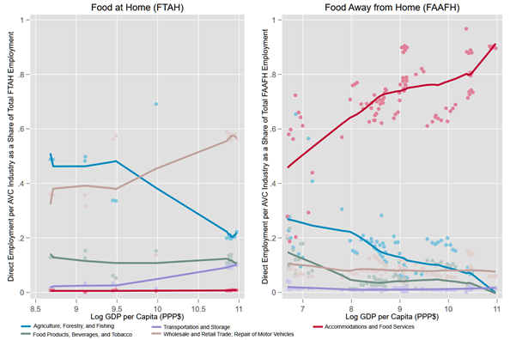
10 Stylized facts
7. AVC employment growth is mainly driven by growth in FAFH and in the food service industry.

Slide 13
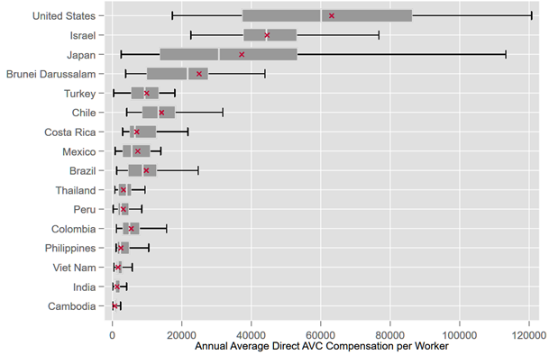
10 Stylized facts
8. AVC compensation per worker largely keeps pace with broader economy. Huge international variation.
x shows overall economywide mean compensation/worker.

Slide 14
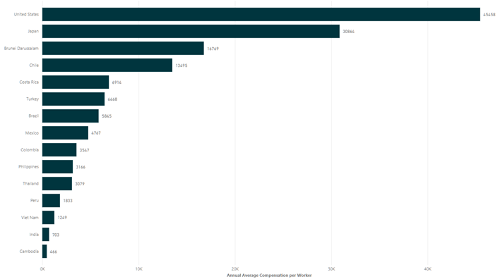
10 Stylized facts
8. AVC compensation per worker largely keeps pace with broader economy. Huge international variation.

Slide 15
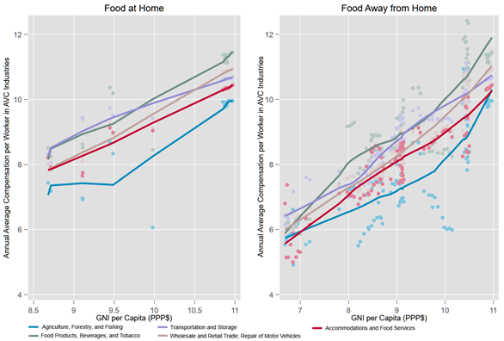
10 Stylized facts
9. Best compensated AVC jobs are in more capital-intensive industries (manufacturing/processing, transport/storage, wholesale/retail). Compensation lowest in primary production and food service.

Slide 16
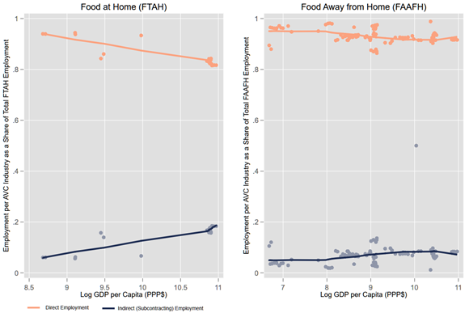
10 Stylized facts
10. Subcontracting is modest but rises with incomes, and indirect labor earns higher compensation than direct industry employees do.

Slide 17
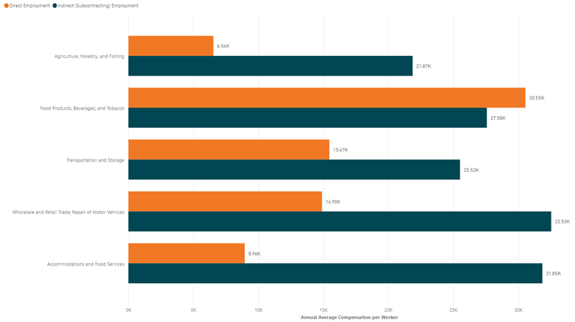
10 Stylized facts
10. Subcontracting is modest but rises with incomes, and indirect labor earns higher compensation than direct industry employees do.

Slide 18
Extensions
GE model:
GE model adapting Lagakos & Waugh (AER 2013) to explain these patterns as a result of exogenous income growth
GVCs:
The GFD is built for domestic AVCs. Extend to GVCs. Same patterns in GVCs? How do DVCs/GVCs differ? What role for (own and others’) trade policies (e.g., tariff escalation)?

Slide 19
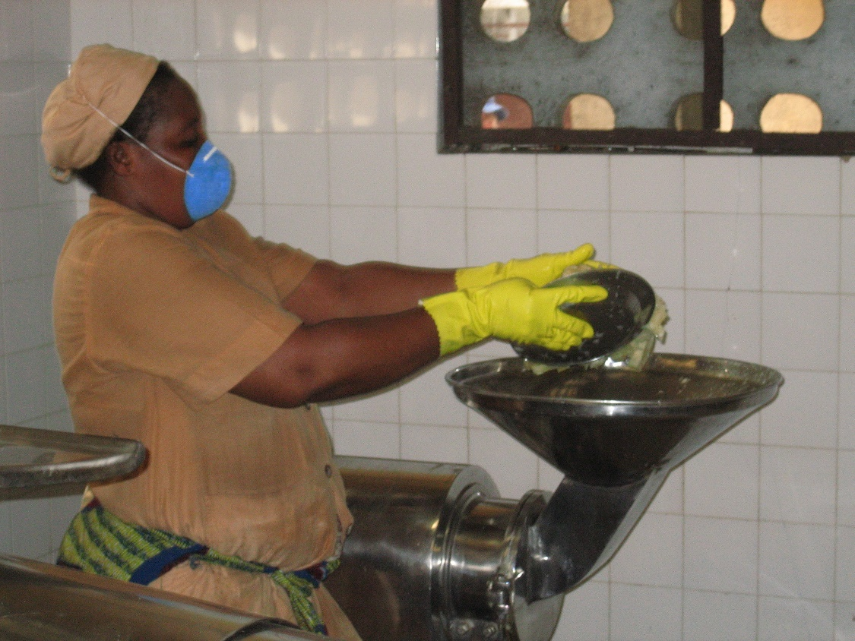
Thank you
Thank you for your time and attention
Comments/questions?

